Slide 1

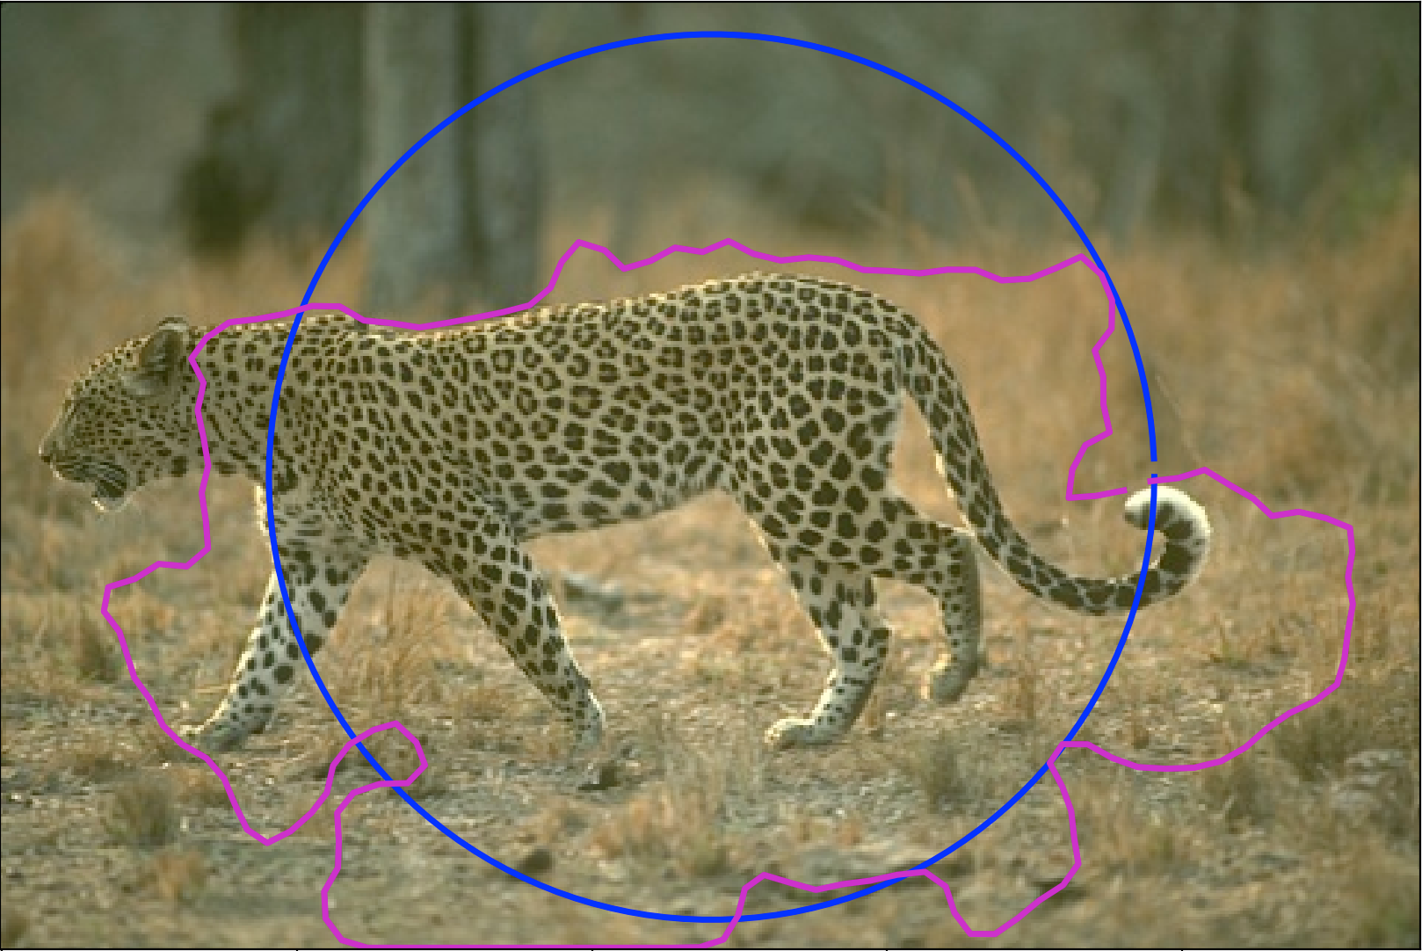
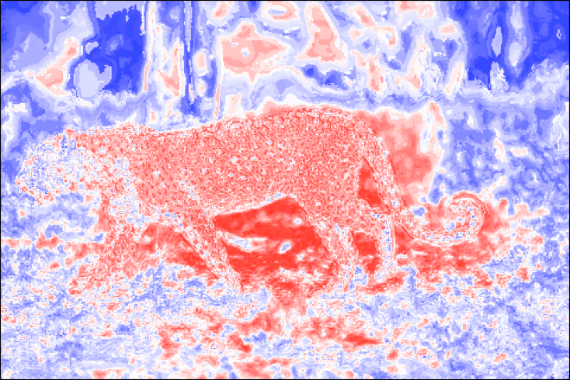
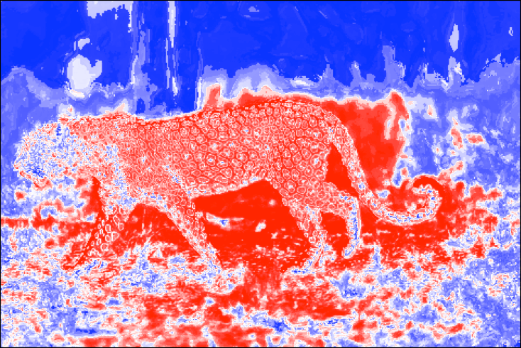
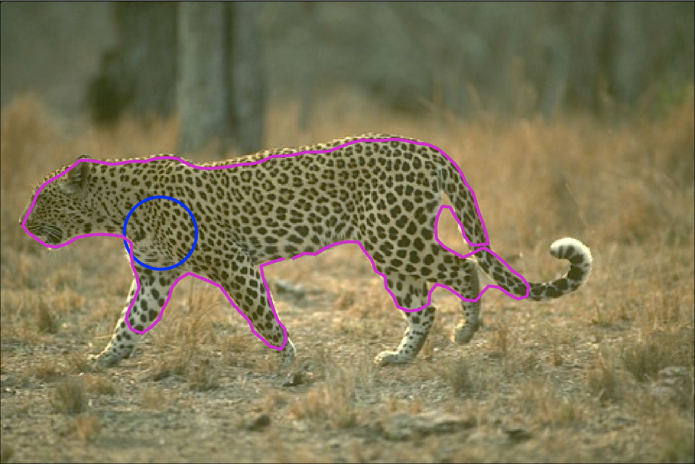
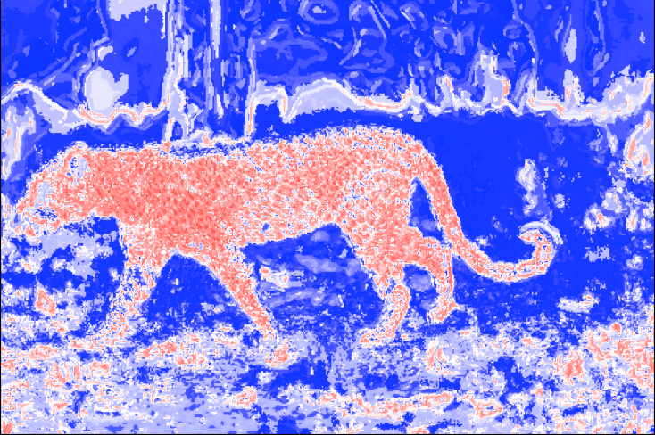
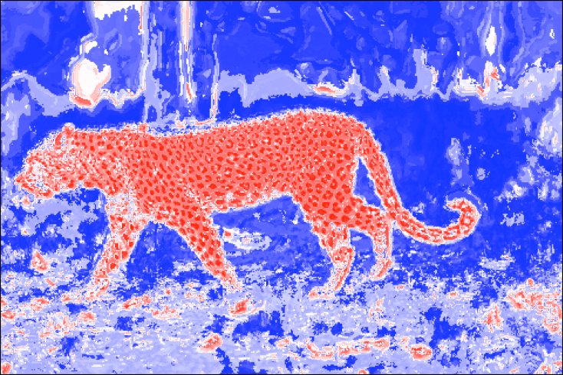
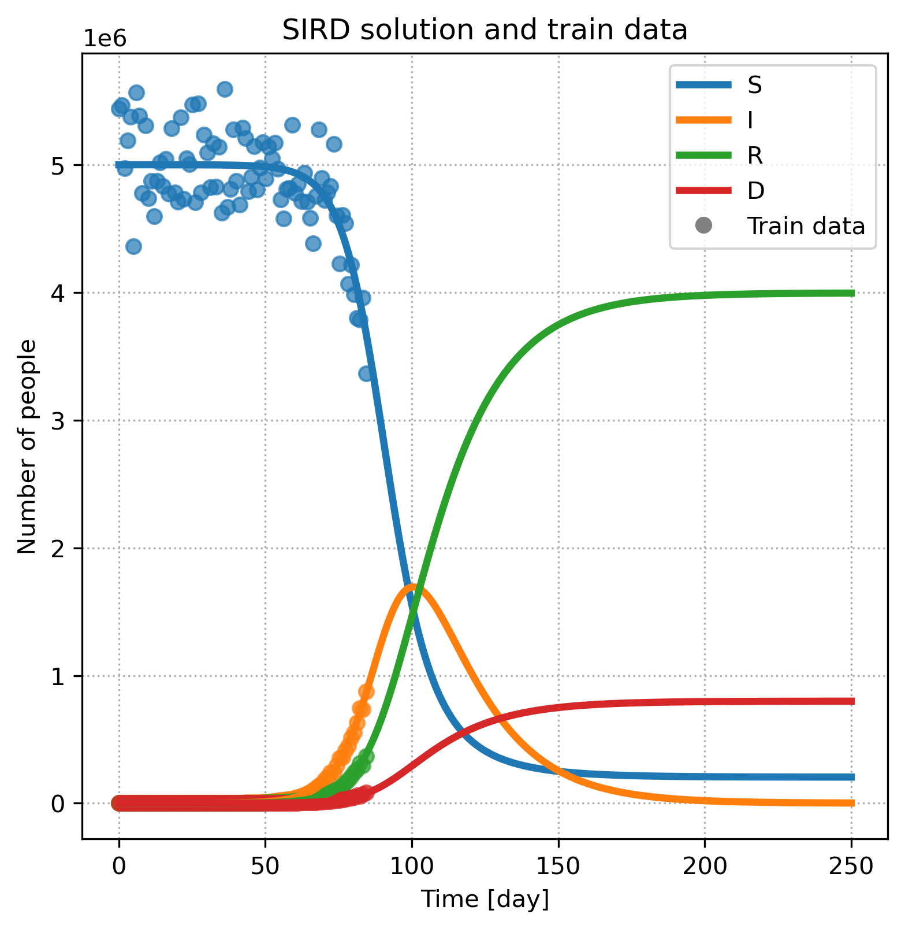
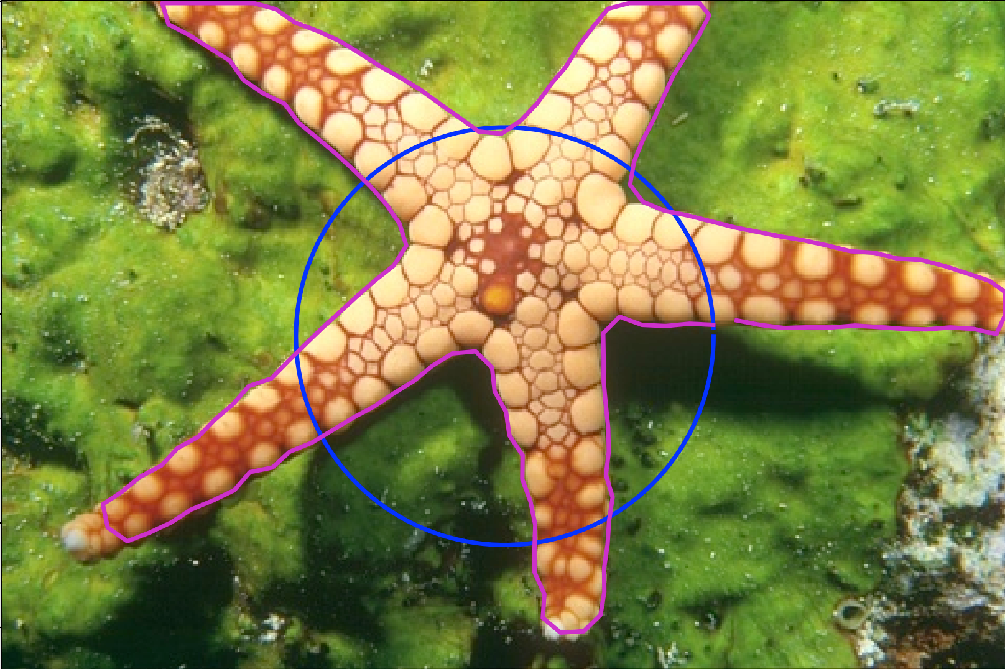
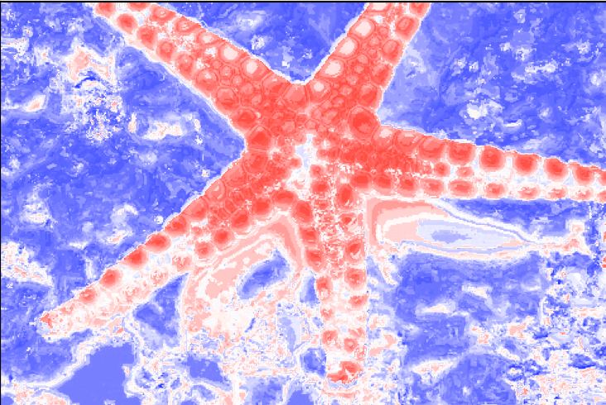
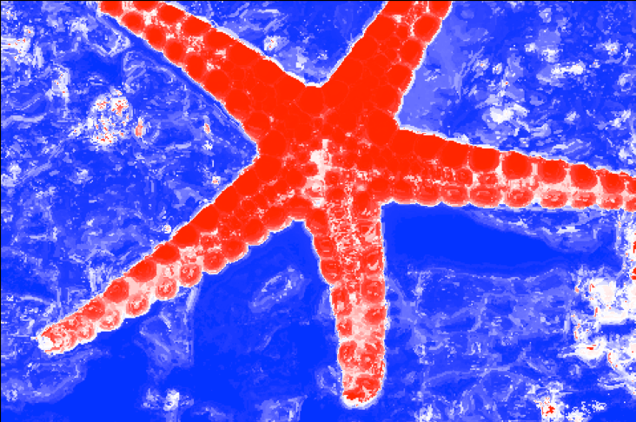
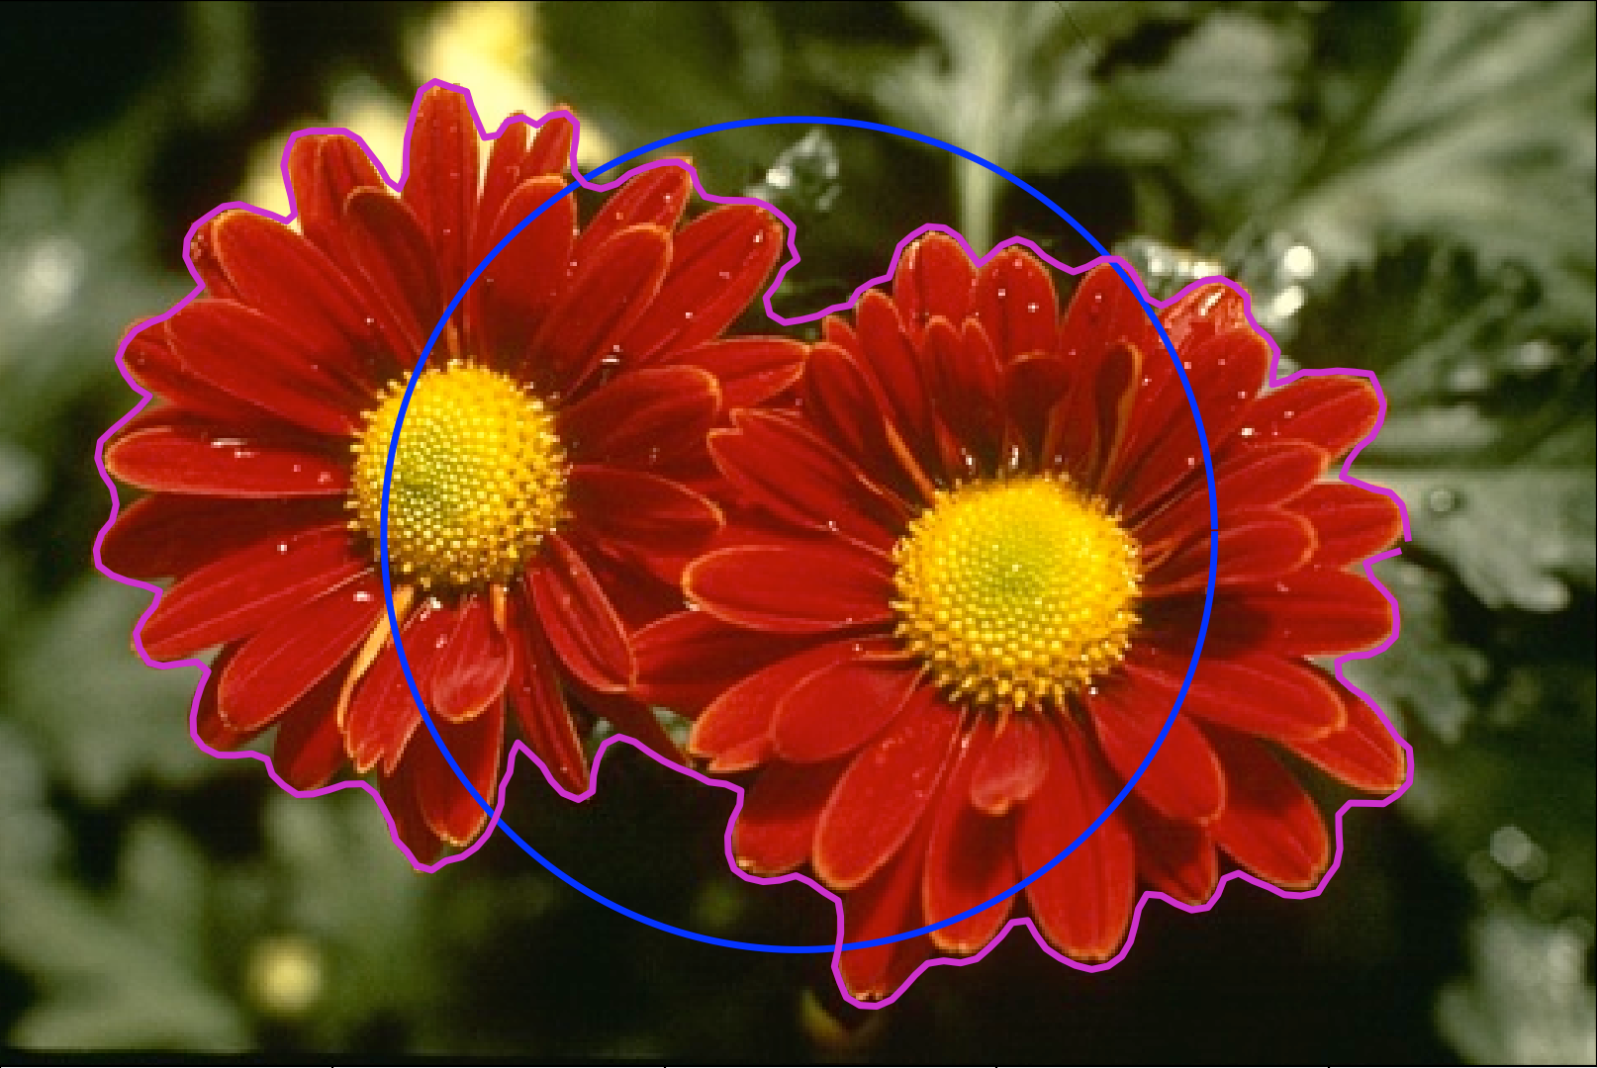
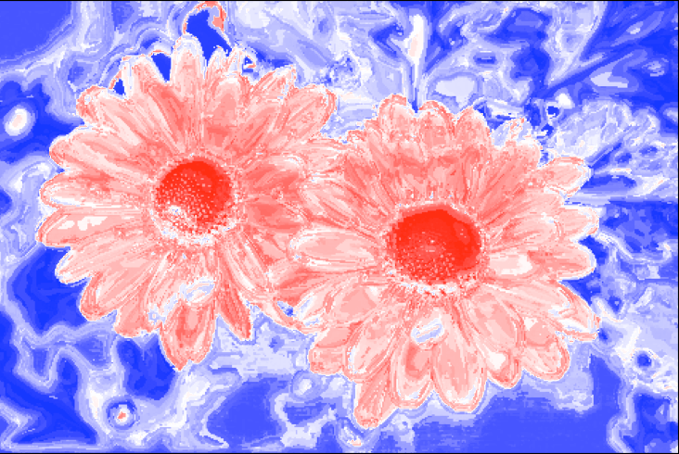
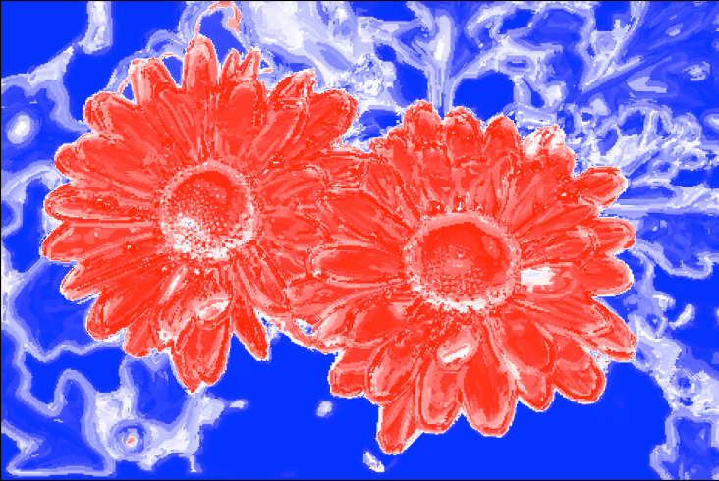
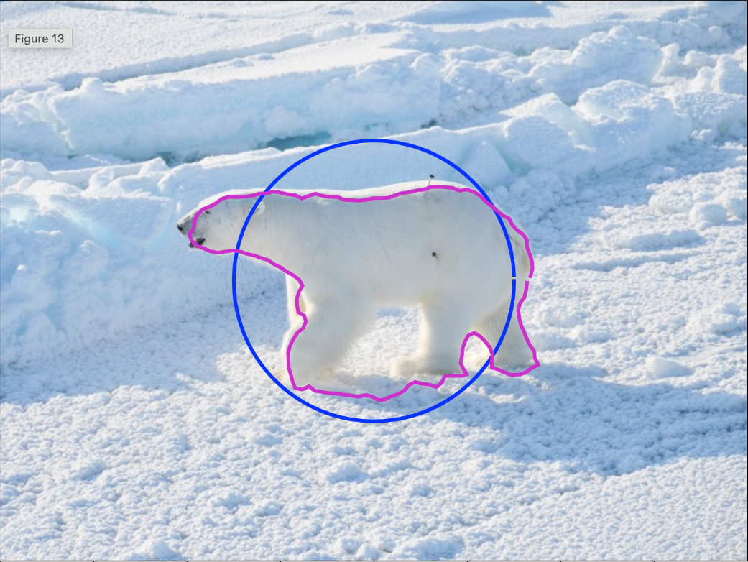
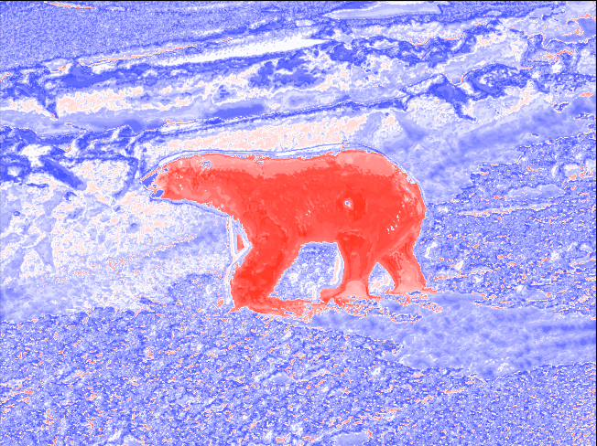
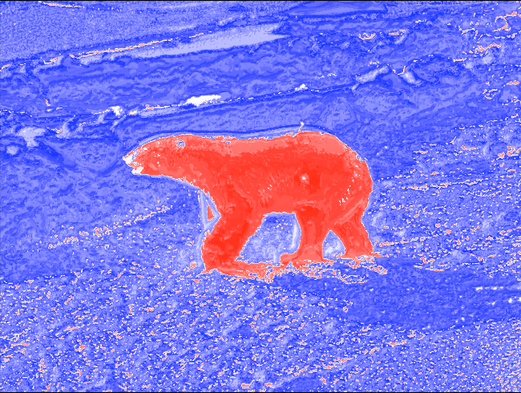
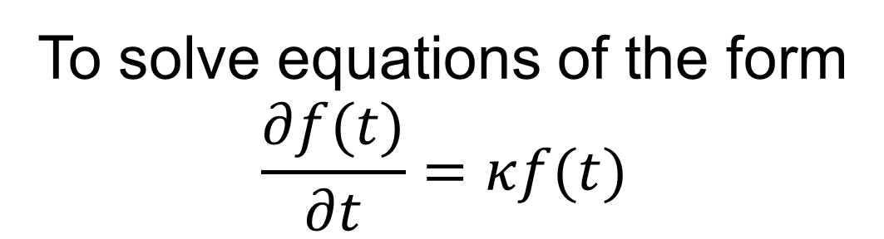
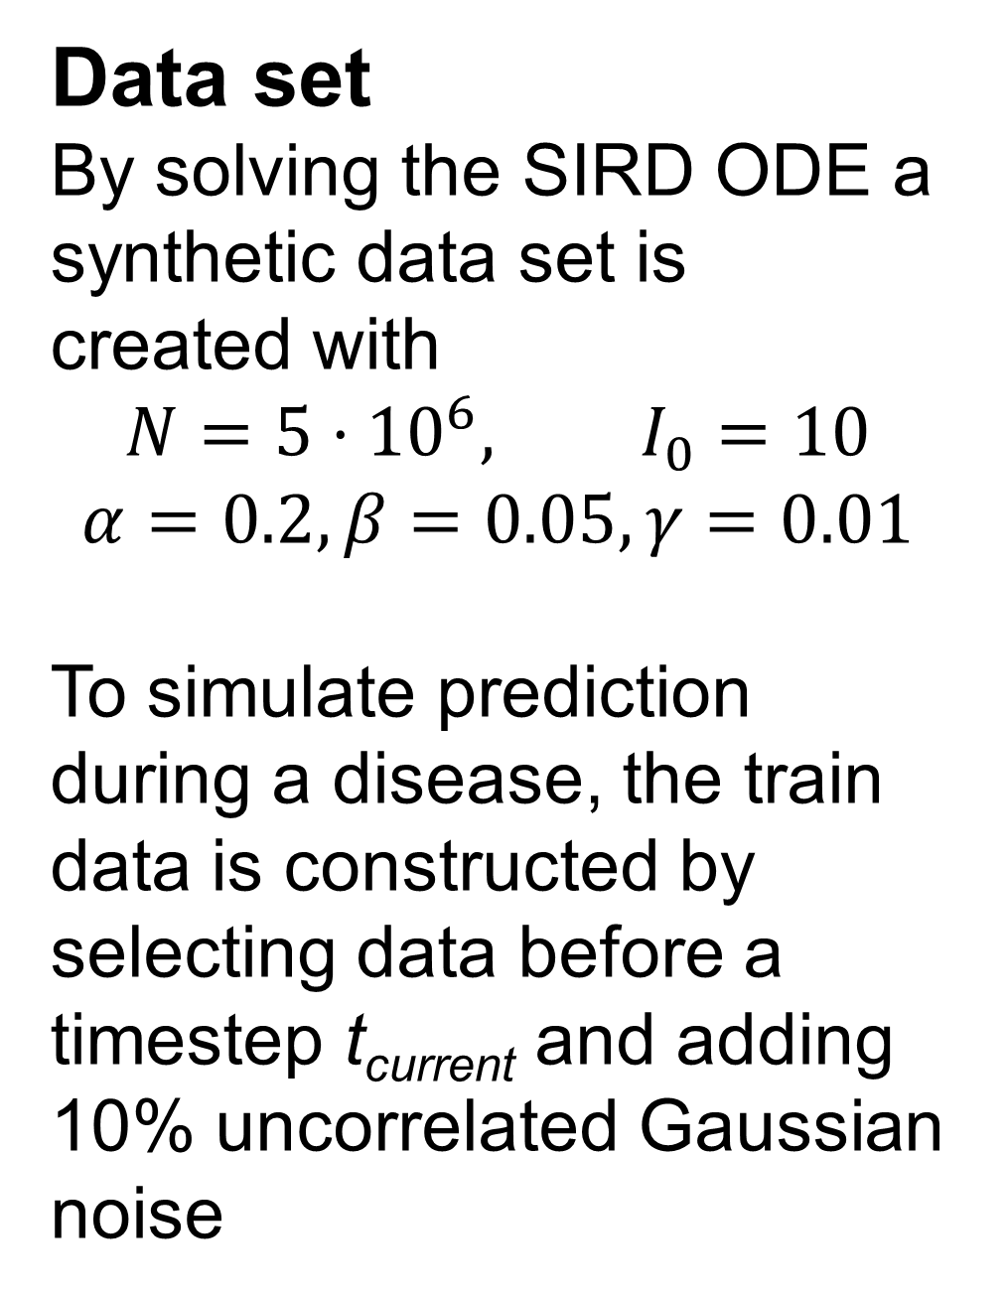
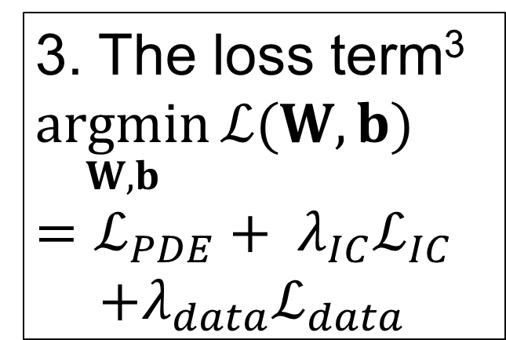
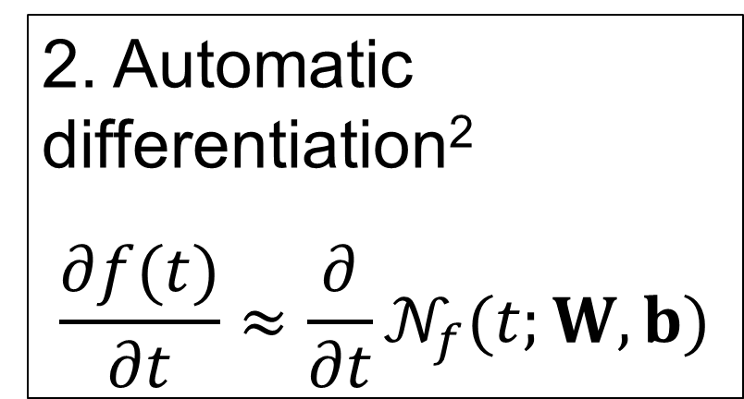
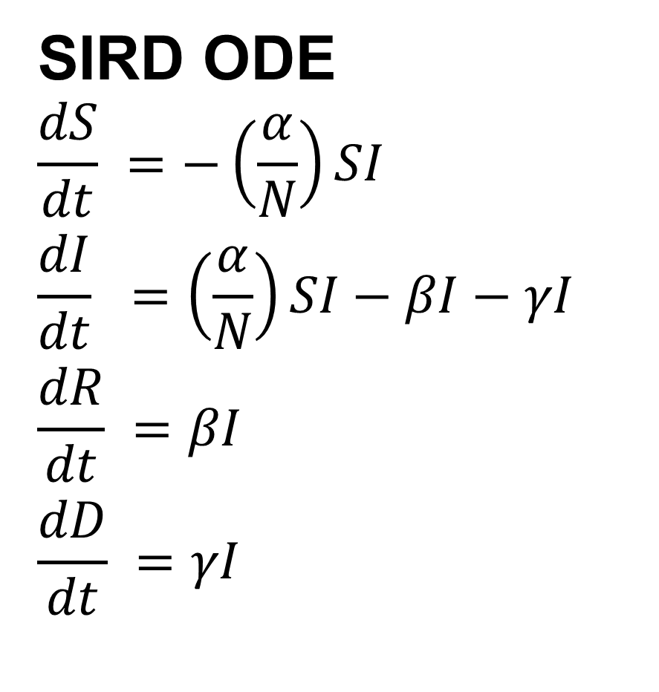
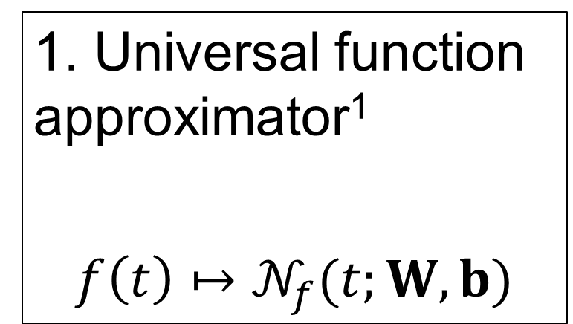
Finding a Polar Bear on Ice - Using Probabilistic Chan-Vese
02456 Deep Learning
Poster Session 8/12/2022
By: J. Hammer Hedeman and William S. Hansen
Introduction
Peak prediction
The purpose of this project is to model Covid-19 spread using physics-informed neural networks (PINN).
Initialize snake.
2. Create color and texture dictionary.
3. Create inside and outside histograms.
4. Calculate probabilities from the snake points.
5. Calculate and apply forces to snake.
6. Repeat step 3 – 5 until convergence condition is met.
Theory
PINNs combine traditional neural networks with underlying physics knowledge described by general nonlinear ordinary differential equations (ODE) to enhance the effectiveness of the network.
Two strains
To solve equations of the form
$$\frac{∂f(t)}{∂t}=κf(t)$$
Initial condition had profound effect on the results. However, even bad initial conditions gave useful results.
From left to right: Initial snake (blue) / final snake (magenta), Initial probability map, and final probability map (red = pin).
1. Universal function approximator¹
$$f\left(t\right)↦𝒩_{f}(t;W,b)$$
2. Automatic differentiation²
$$\frac{∂f(t)}{∂t}≈\frac{∂}{∂t}𝒩_{f}(t;W,b)$$
3. The loss term³
$$\underset{W,b}{argmin}{ℒ(W,b)}=ℒ_{PDE}+ λ_{IC}ℒ_{IC}$$
$$+λ_{data}ℒ_{data}$$
SIRD model
The SIRD model describes the spread of an infectious disease by dividing the population (N) into the four compartments susceptible (S), infected (I), recovered (R), and dead (D) linked by coupled ODEs
SIRD ODE
$$\frac{dS}{dt} =−\left(\frac{α}{N}\right)SI$$
$$\frac{dI}{dt} =\left(\frac{α}{N}\right)SI−βI−γI$$
$$\frac{dR}{dt} =βI$$
$$\frac{dD}{dt} =γI$$
Danish Covid-19 data
Data set
By solving the SIRD ODE a synthetic data set is created with
$$N=5⋅{10}^{6}, I_{0}=10$$
$$α=0.2, β=0.05,γ=0.01$$
To simulate prediction during a disease, the train data is constructed by selecting data before a timestep t_{current} and adding 10% uncorrelated Gaussian noise
These are some of the results based on best weight between parameters.
Using a neural network
Importance of peak prediction
Text
text
Future improvements
Being able to work with multiple areas as foreground.
Minimize influence of initial conditions, such as the placement and size of the initial snake. This could be done by initialising several snakes in different position, making a probability map from each result, and use this to find the foreground.
DeVore et al. (2020)
Baydin et al. (2018)
Borrel-Jensen et al. (2021)
Notes:
Tekst og Streger i 100% farve – Baggrund i 90% Transparent.

Slide 2
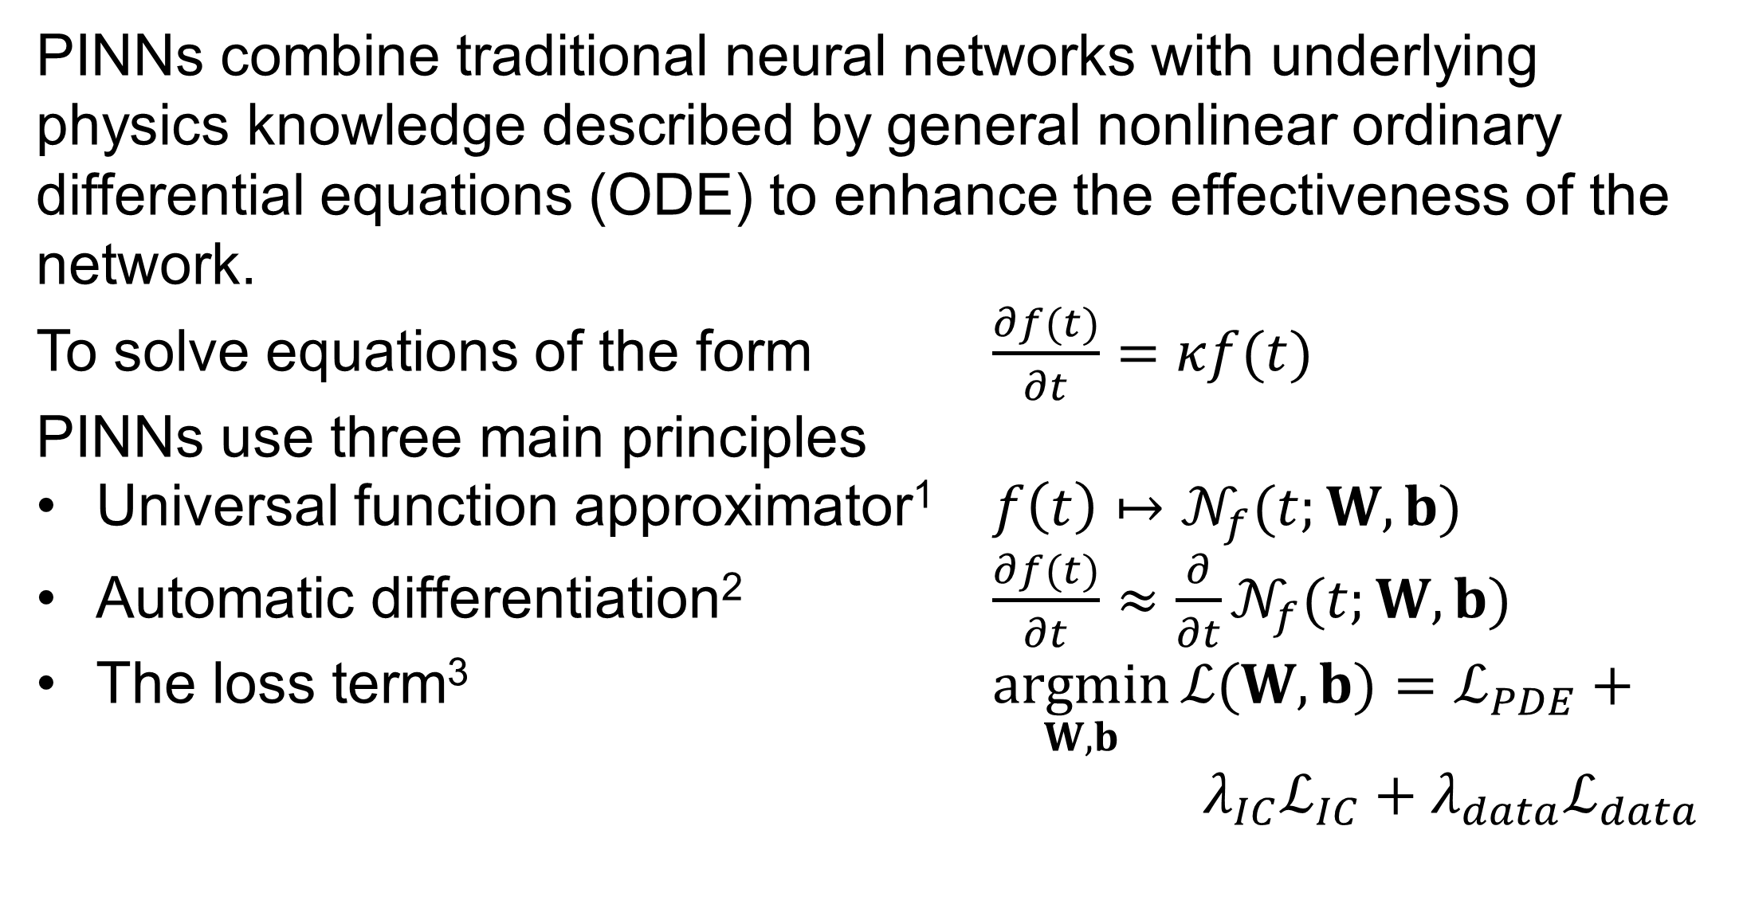
$ℒ_{PDE}=\left\|\frac{∂}{∂t}𝒩_{f}\left(t;W,b\right)−κ𝒩_{f}\left(t;W,b\right)(t) \right\|$
$ℒ_{IC}=\left\|𝒩_{f}\left(0;W,b\right)−f_{0}\right\|$
$ℒ_{data}=\left\|𝒩_{f}\left(t_{data};W,b\right)−f_{data}\right\|$
PINNs combine traditional neural networks with underlying physics knowledge described by general nonlinear ordinary differential equations (ODE) to enhance the effectiveness of the network.
To solve equations of the form $\frac{∂f(t)}{∂t}=κf(t)$
PINNs use three main principles
Universal function approximator¹ $f\left(t\right)↦𝒩_{f}(t;W,b)$
Automatic differentiation² $\frac{∂f(t)}{∂t}≈\frac{∂}{∂t}𝒩_{f}(t;W,b)$
The loss term³ $\underset{W,b}{argmin}{ℒ(W,b)}=ℒ_{PDE}+ λ_{IC}ℒ_{IC}+λ_{data}ℒ_{data}$

